Slide 1





International E-Marketing to China:
How Live Streaming is influencing buying behavior on the Example of Taobao Live

Slide 2

The emerging trend
Of Live Streaming
$60,000,000,000
That’s live streaming’s estimated annual worth

Slide 3
What are the aims of this research?
1. Indicate…
…exactly what factors of live streaming platforms influence consumer buying behavior.
2. Identify…
…the audiences that are most suitable for live streaming marketing strategies.

Slide 4
Significance
Assists local businesses in strategy choice
Assist foreign businesses in penetrating the market
Supports further research in e-marketing

Slide 5
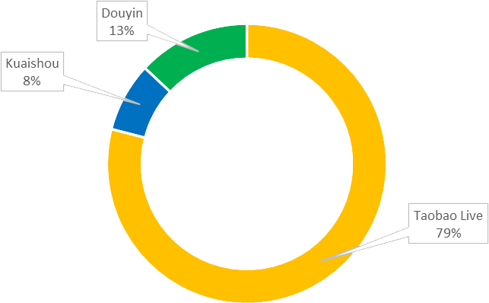


Case Platform
79% of the live streaming market share belongs to Taobao Live

Slide 6
Methodology
Analyze
Build a linear regression analysis model based on the survey responses and test the hypotheses against it
3
Survey
Design a questionnaire based on the hypotheses and conduct a survey among Chinese internet users
2
Hypothesize
Inspect academic literature and derive relevant hypotheses that would serve as the foundation for research
1

Slide 7
1. Hypotheses
Theoretical assumptions on what factors of live streaming influence buying behavior

Slide 8
H1. Taobao Live influences buying behavior because its environment allows users to familiarize with the products in more detail.
- Derived from the theory behind complex buying behavior

Slide 9
H1 further breaks down to:
H1a: Taobao Live provides detailed information on products in general
H1b: Taobao Live provides detailed information on products use and features
H1c: Taobao Live provides detailed information on products quality
H1d: Taobao Live provides detailed information on products appearance

Slide 10
H2. Taobao Live successfully handles dissonance-reducing buying behavior by providing more visibility to the products.
- Derived from the theory behind
dissonance-reducing buying behavior

Slide 11
H3. Taobao Live is influencing buying behavior, because it provides a highly interactive platform both among users and between users and businesses.
- Derived from “Principles of Marketing”
by Kotler and Armstrong (2010)

Slide 12
H4. Taobao Live influences buying behavior because it provides a platform, where consumers can be highly engaged with the brands and form brand loyalty.
- Derived from the works of Rong-An Shang (2006)
and Anne Mollen & Hugh Wilson (2010)

Slide 13
2. Survey
The survey conducted among Chinese internet users and it’s results

Slide 14
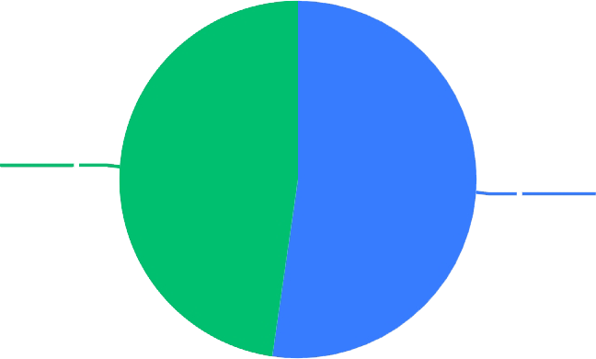

Gender
Q1
女
男
47.7%
52.3%
👨 52.3% of male and
👩 47.7% of female respondents

Slide 15
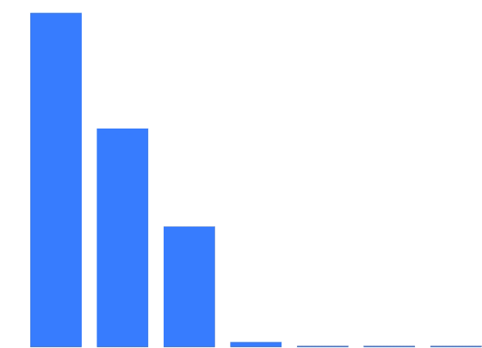

Age
Q2
49.1%
50%
40%
32.1%
30%
20%
17.7%
• Average respondent age is 25 - 30
10%
0.8%
0.2%
0%
0%
0%
25 - 30
18 - 24
31 - 40
< 18
51 - 60
41 - 50
> 61

Slide 16
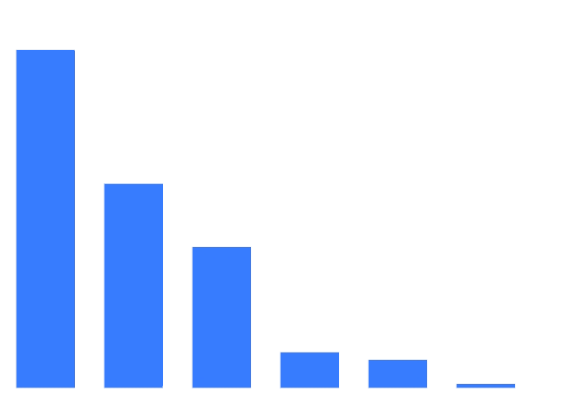
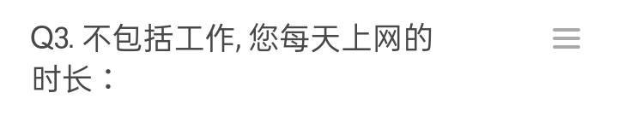
Time Online
Q3
50%
44.9%
40%
30%
27.1%
20%
18.7%
• On average, respondents spent
4 hours online, excluding work
10%
4.7%
3.7%
0.6%
0%
4小时
3小时
5小时
> 5小时
2小时
1小时

Slide 17
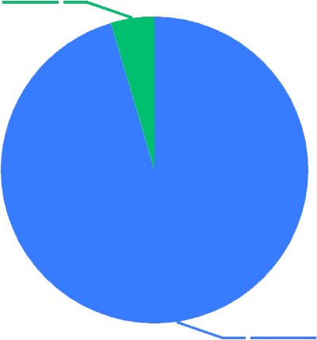
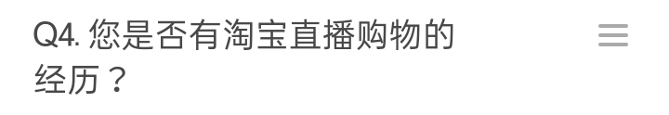
Experience
Q4
否
4.59%
• 4.59% of respondents didn’t have any experience with Taobao Live
• That accounts for people who use other live streaming platforms or do not use any at all
是的
95.41%

Slide 18
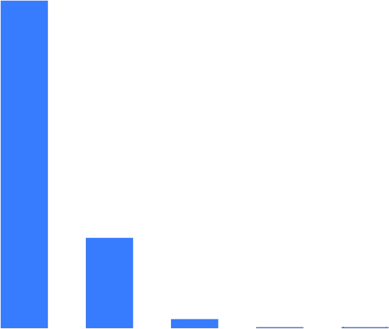
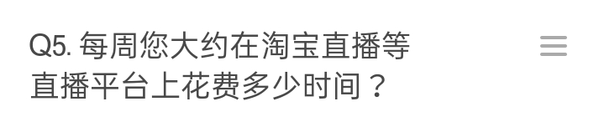
Time on the Platform
Q5
80%
76.45%
64%
48%
32%
On average, respondents spent
around 1 - 3 hours on Taobao Live
21.16%
16%
2.20%
0%
0.20%
0%
1-3小时
0小时
4-6小时
>=10小时
7-9小时

Slide 19
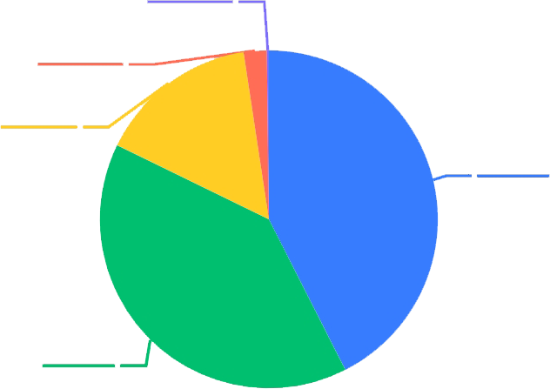
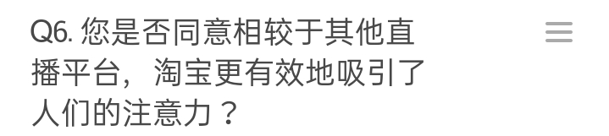
Attraction
Q6
强烈反对
0.20%
> 42% agreed that Taobao Live is more potent at attracting people’s attention towards products
非常同意
2.20%
不同意
15.37%
同意
42.51%
中性
39.72%

Slide 20
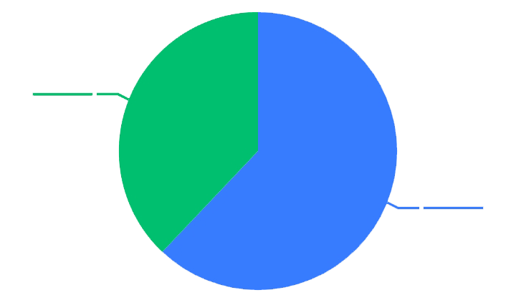
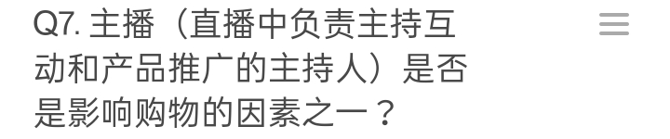
Importance of Host
Q7
否
37.92%
是的
62.08%
62% consider the presence of a host an important factor

Slide 21
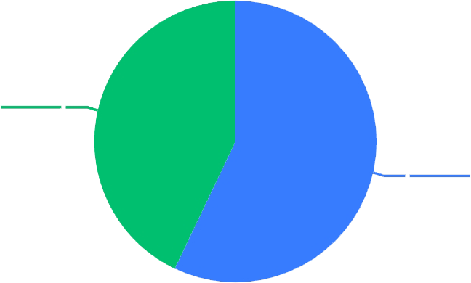
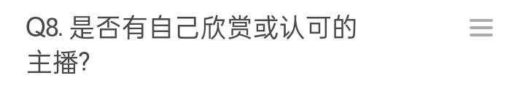
Favorite Hosts
Q8
57% reported having a favorite host
否
42.91%
是的
57.09%

Slide 22
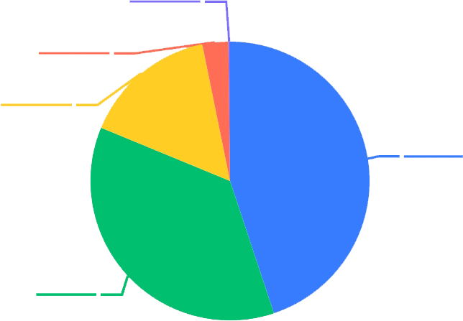
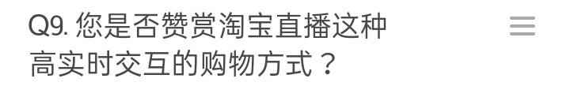
Interactivity
Q9
非常赞赏
> 36% considered the platform highly interactive
0.2%
非常赞赏
2.99%
不是很赞赏
15.57%
中立
44.91%
赞赏
36.33%

Slide 23
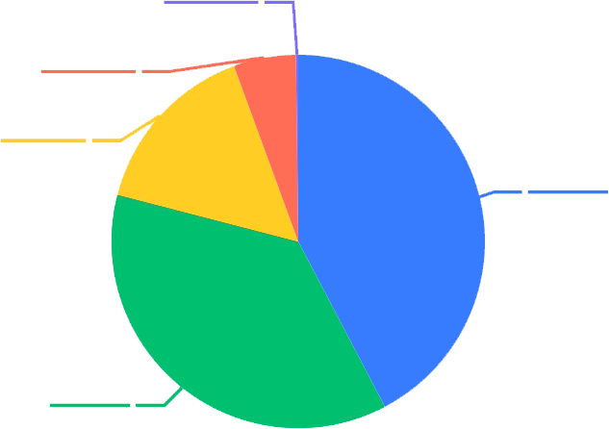
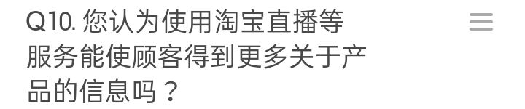
Informativeness
Q10
强烈反对
> 42% agreed that Taobao Live is more potent at attracting people’s attention towards products
0.20%
非常同意
5.39%
不同意
15.37%
同意
42.32%
中性
36.73%

Slide 24
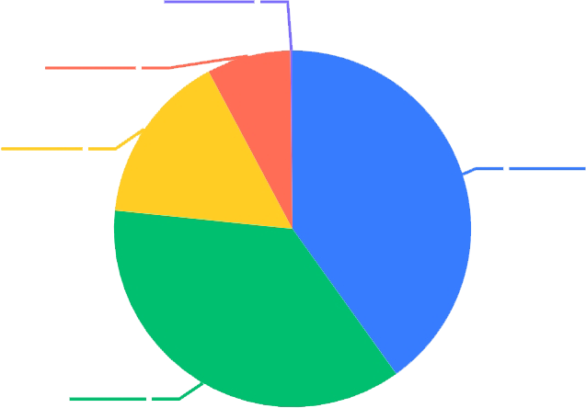
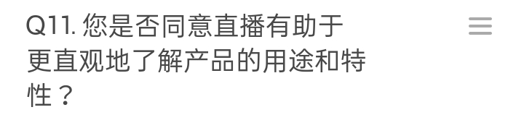
Use and Features
Q11
强烈反对
> 40% agreed that the platform is more informative about product use and features than other media
0.20%
非常同意
7.58%
不同意
同意
15.57%
40.12%
中性
36.53%

Slide 25

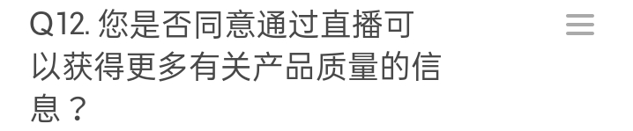
Product Quality
Q12
强烈反对
> 43% agreed that the platform provides more information about product quality
0.20%
非常同意
4.19%
不同意
16.37%
同意
43.51%
中性
35.73%

Slide 26
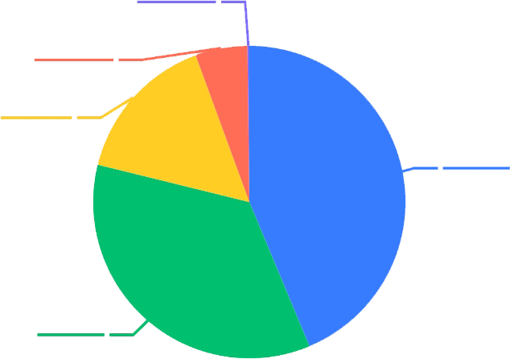
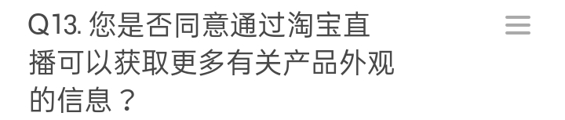
Appearance
Q13
强烈反对
> 43% also agreed that the platform provides more information about product appearance
0.20%
非常同意
5.39%
不同意
15.57%
同意
43.71%
中性
35.13%

Slide 27
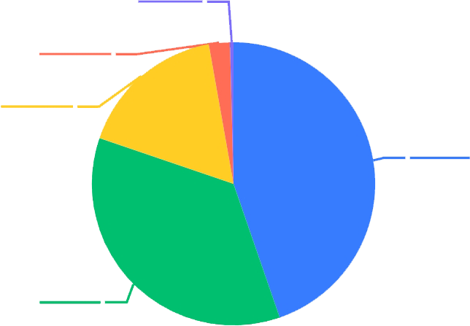

Influence
Q14
不可能
0.40%
> 35% reported that they can be influenced by the platform to do online shopping
很大可能
2.40%
不太可能
16.97%
中立
44.71%
可能
35.53%

Slide 28
3. Analysis
Testing the hypotheses against linear regression model of the survey results

Slide 29
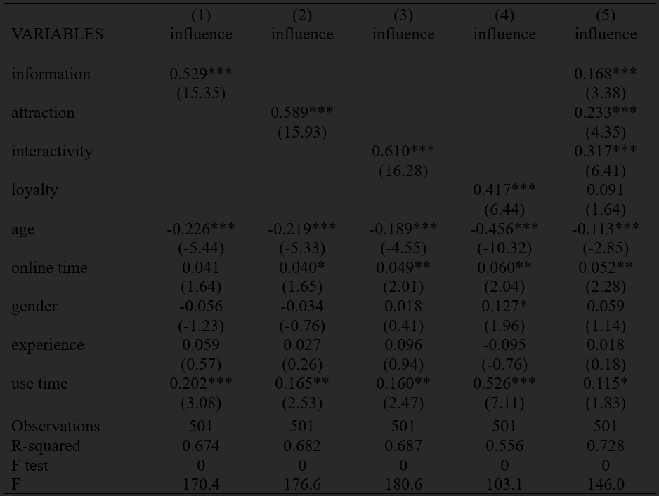
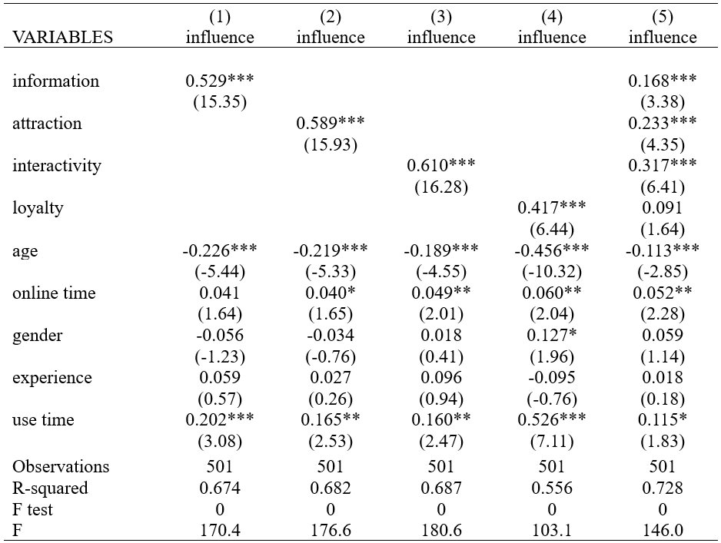

Slide 30
Conclusions: 1. Indicated Factors
The data from the survey confirms all the four suggested hypotheses. Most important factors that influence buying behavior are:
Informativeness (.168), attraction (0.233), interactivity (.317), and loyalty to a smaller extent (0.091)

Slide 31
Conclusions: 2. Identified Audiences
Negative relationship between age and influence
Women tend to be more influenced than men
Positive relationship between time online and on the platform and the likelihood of the influence

Slide 32


Thanks!
Ready to answer your questions

